Slide 1
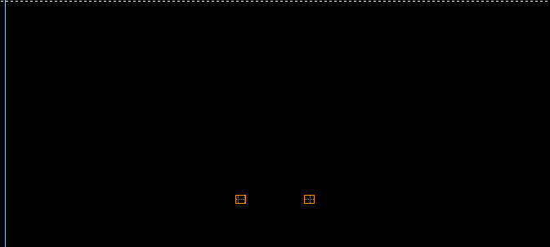
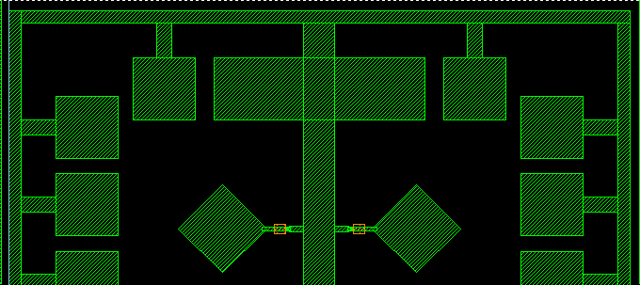
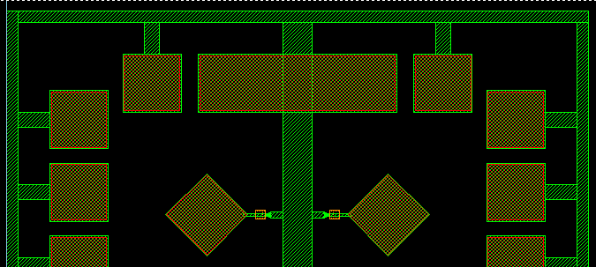
1. Nb Plug Deposition
Pattern lift-off mask for Nb plugs, deposit Nb, 200 nm, and lift off.
Nb
Si₃N₄
Nb
Si Substrate
2. Trilayer Deposition Deposit Al trilayer, Al(265)/Al-Ox/Al(60) (thickness in nm).
Nb
Si₃N₄
Nb
Si Substrate
NA
Ion Mill
Resist
3. Base Layer Patterning. Pattern base electrode layer, wiring and pads with resist mask, and ion mill through top Al layer; strip resist.
Nb
Si₃N₄
Nb
Si Substrate
Resist
4. Counter-Electrode Patterning. Pattern top counter-electrode layer with resist mask, ion mill down to base layer and to clear field areas, anodize to 70V; strip resist.
Nb
Si₃N₄
Nb
Si Substrate

Slide 2
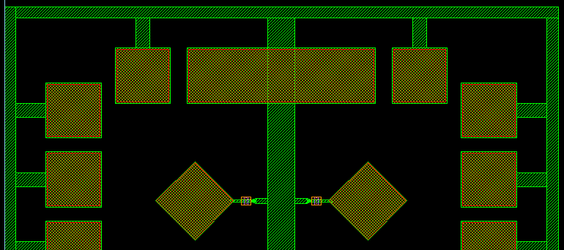
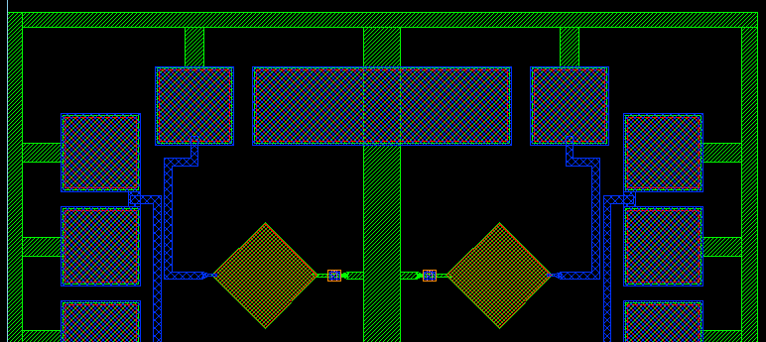
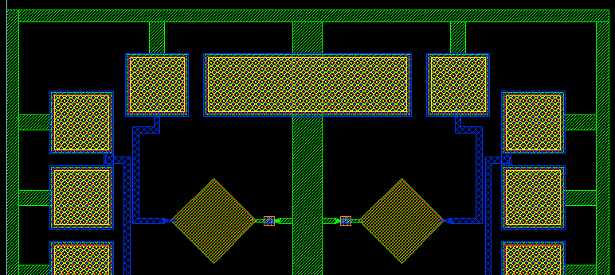
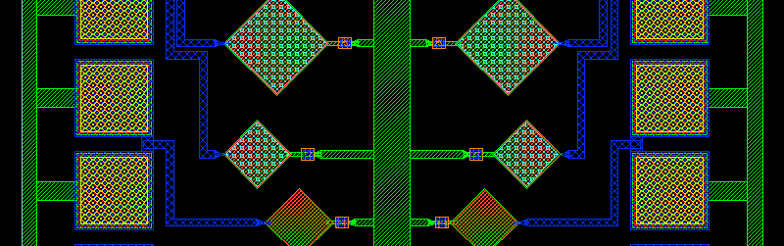
5. Link Etch Pattern resist mask with windows over anodized Al base wiring where Nb plugs will be formed, ion mill to remove anodized Al and underlying Al (depth TBD); strip resist.
Resist
Nb
Si₃N₄
Nb
Si Substrate
6. Nb Wiring Deposition Pattern lift-off mask for Nb wiring and pads, deposit Nb, 600 nm, and lift off.
Nb
Si₃N₄
Nb
Si Substrate
7. Au Pad Deposition Pattern lift-off mask for Au pads, deposit Au, 300 nm, and lift off.
8. Absorber Deposition Pattern lift-off mask for Pb absorbers, deposit Pb, thickness TBD, lift off.

Slide 3
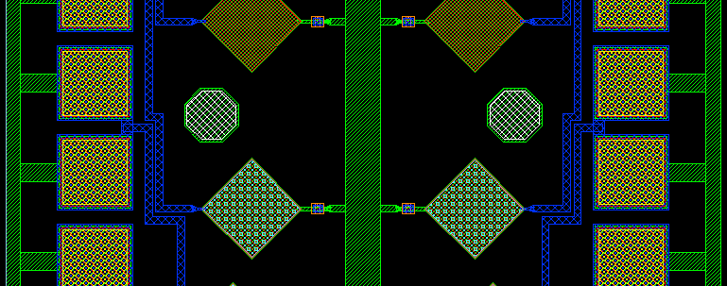
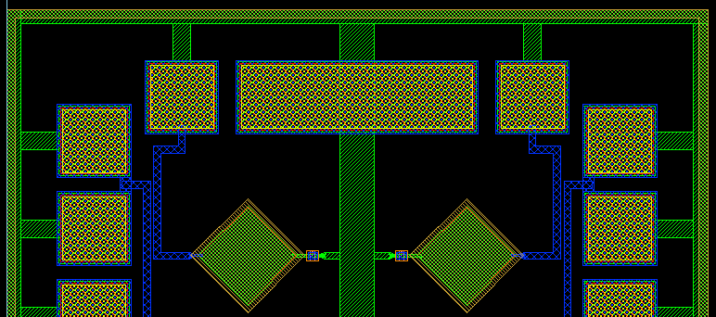
9. SU-8 Post Formation. Spin coat wafer with SU-8, thickness TBD, and pattern collimator posts.
10. Backside Etch. Bond wafer to backing wafer, face down, pattern backside resist mask, etch through wafer to release membranes; remove die from backing wafer and clean.

Slide 4
CAD Layer | GDS | Sequence | Digitized Data | Resist Polarity | Description
Plug | 1 | 1 | Dark | Neg | Nb plugs
Base | 3 | 3 | Dark | Pos | Base layer etch
Cntr | 4 | 4 | Dark | Pos | Counter-electrode etch and anodization
Etch | 9 | 5 | Clear | Pos | Link etch
Wire | 8 | 6 | Dark | Neg | Nb wiring and pads
Au | 14 | 7 | Dark | Neg | Au pads
Abs | 10 | 8 | Dark | Neg | Pb absorber
SU8 | 18 | 9 | Clear | Neg | SU8 posts
Col | 16 | - | Dark | Pos | Collimator
Key | 20 | - | Clear | Pos | Key etch for collimators
DE | 7 | 10 | Clear | Pos | Deep etch to release membranes
PVIA | 15 | - | Clear | Pos | Pad etch (not used)

